Slide 1
NCP CCE-LTER
Discussion April 19th 2018

Slide 2
NCP and FRRF (GPP)
Model
DATA:
MIMS and EIMS O2/Ar
MIMS profiles
Ship data
2 SEASOAR transects- high spatial resolution MLD prior and after the stations
4 stations (2 with high productivity)
4 transects through filament

Slide 3
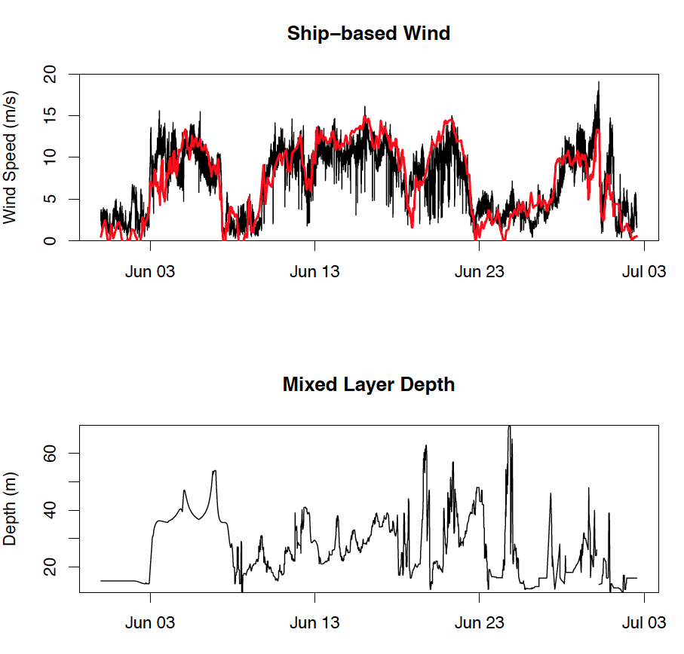
Wind - MLD

Slide 4
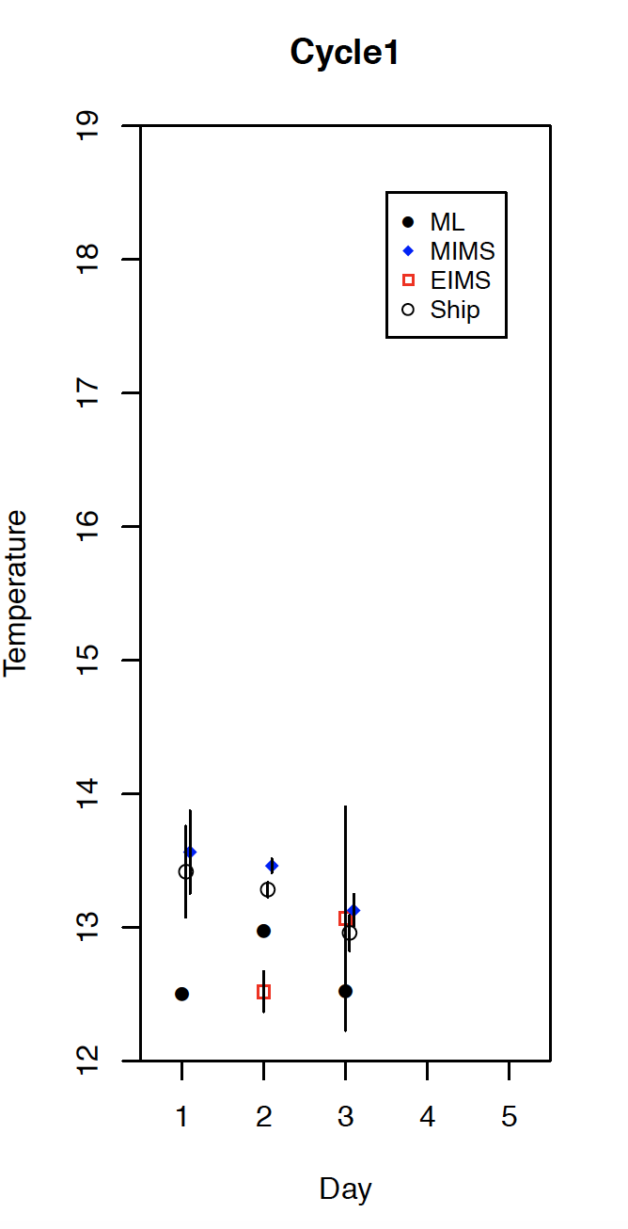
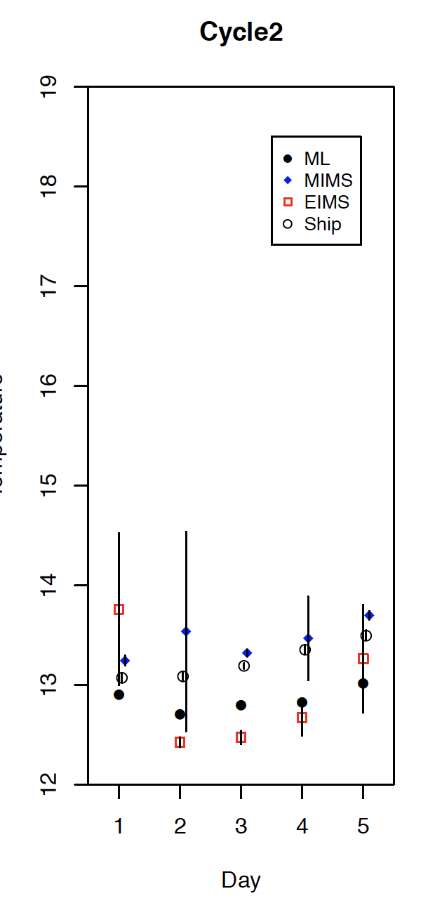
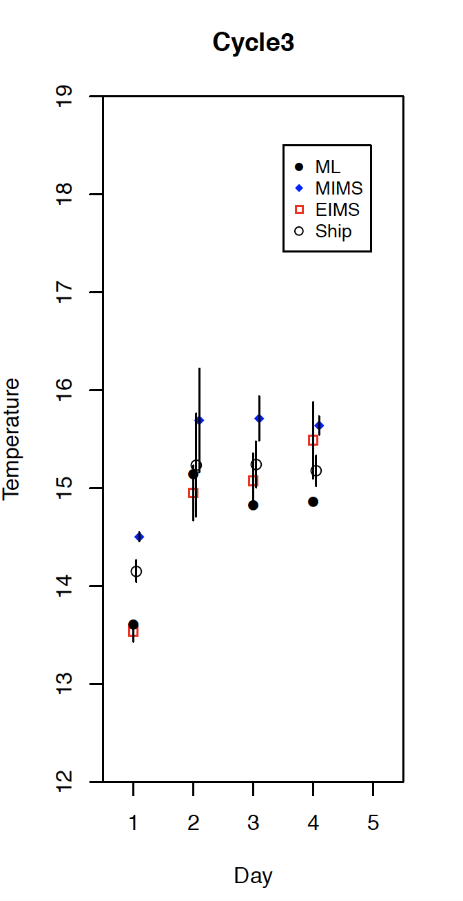
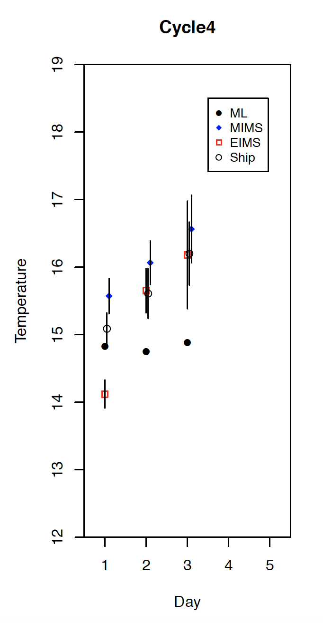
EIMS / MIMS / ship-data temperature comparison
All data fall within 1C difference
Ship and MIMS seem to overlap best!
EIMS seems to have some negative (not consistent) offset
ML: mixed layer average temp
Temp (ship) is used for O2 solubility in NCP calc!
Discussion on which thermometer we should use!

Slide 5
R-code
https://github.com/tbrycekelly/MIMS-TBK

Slide 6
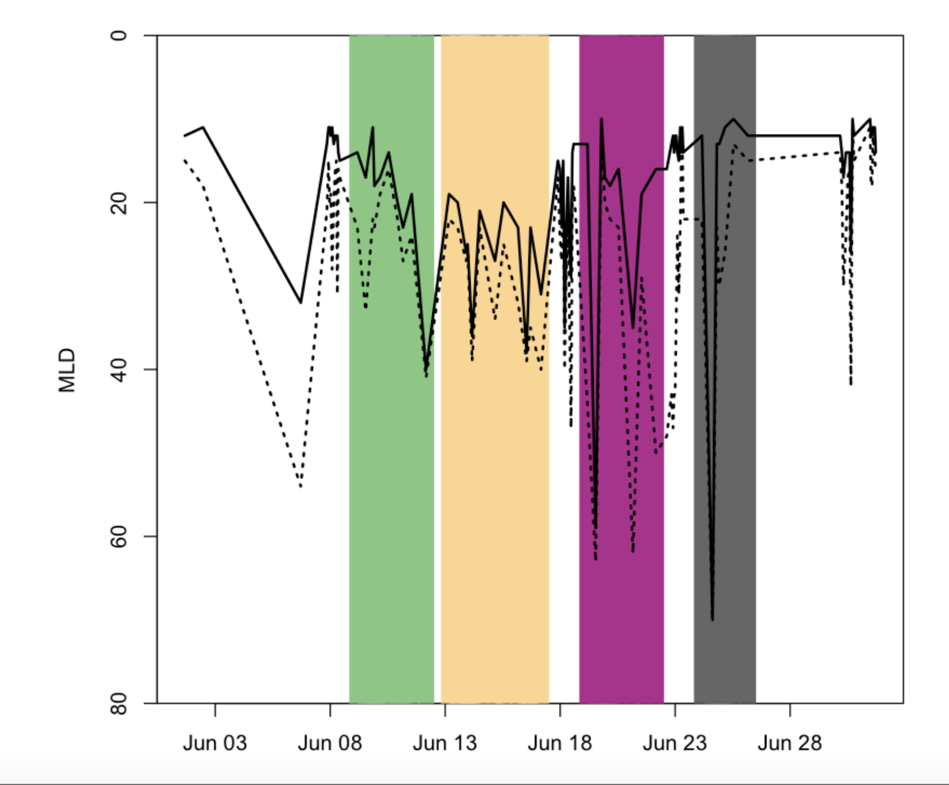
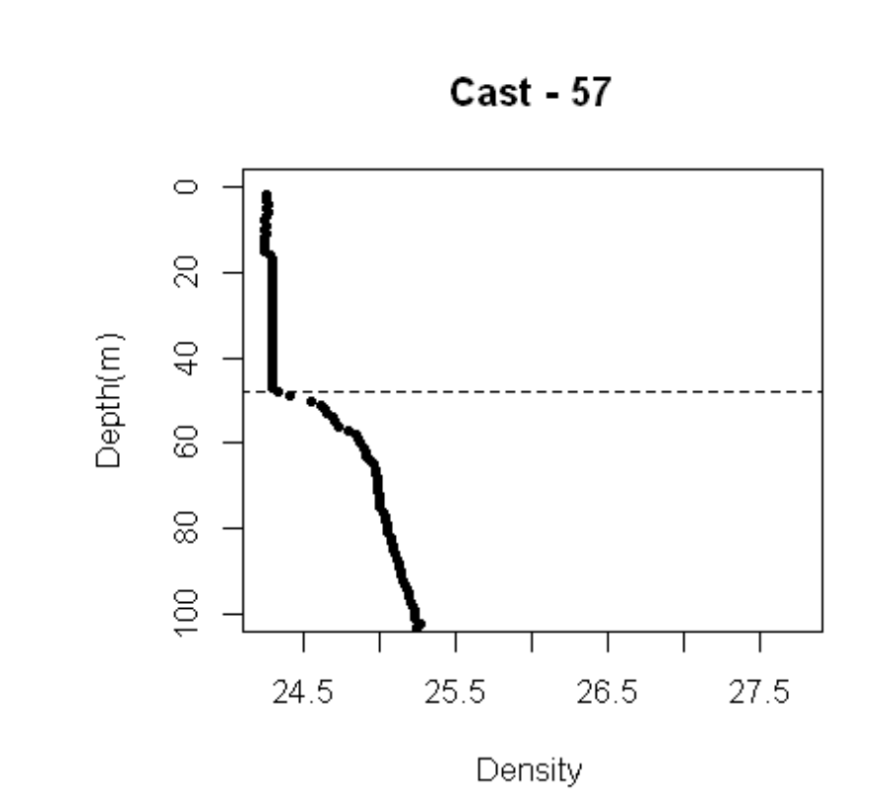
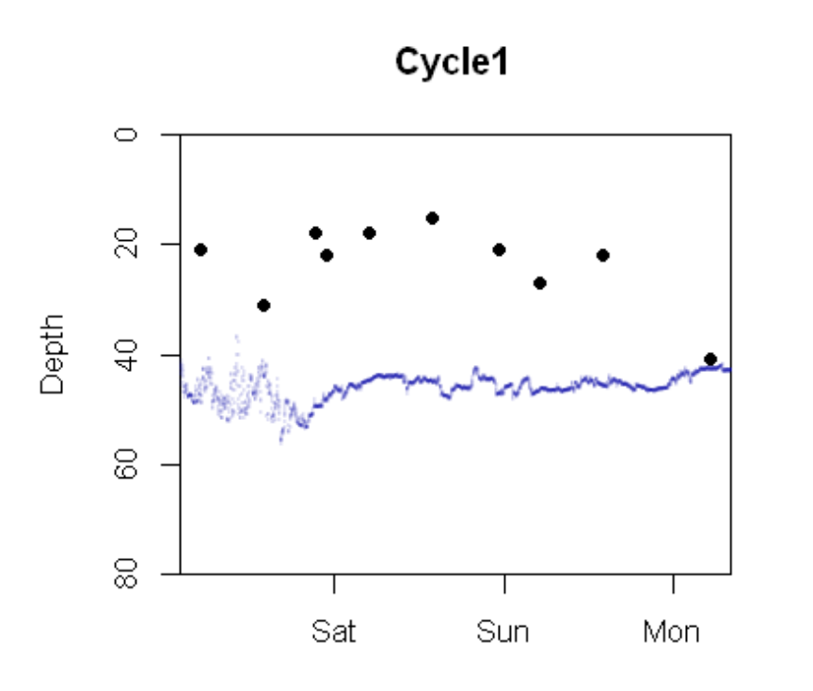
NCP parametrization
Wind data from NARR database!
Parameterization from Wanninkof 2014
k calculated as in Reuer 2007
MLD = from CTDs and seasoar estimated by ∆ρ= 0.1
O2/Ar from EIMS and MIMS
MLD
Blue line = temp

Slide 7
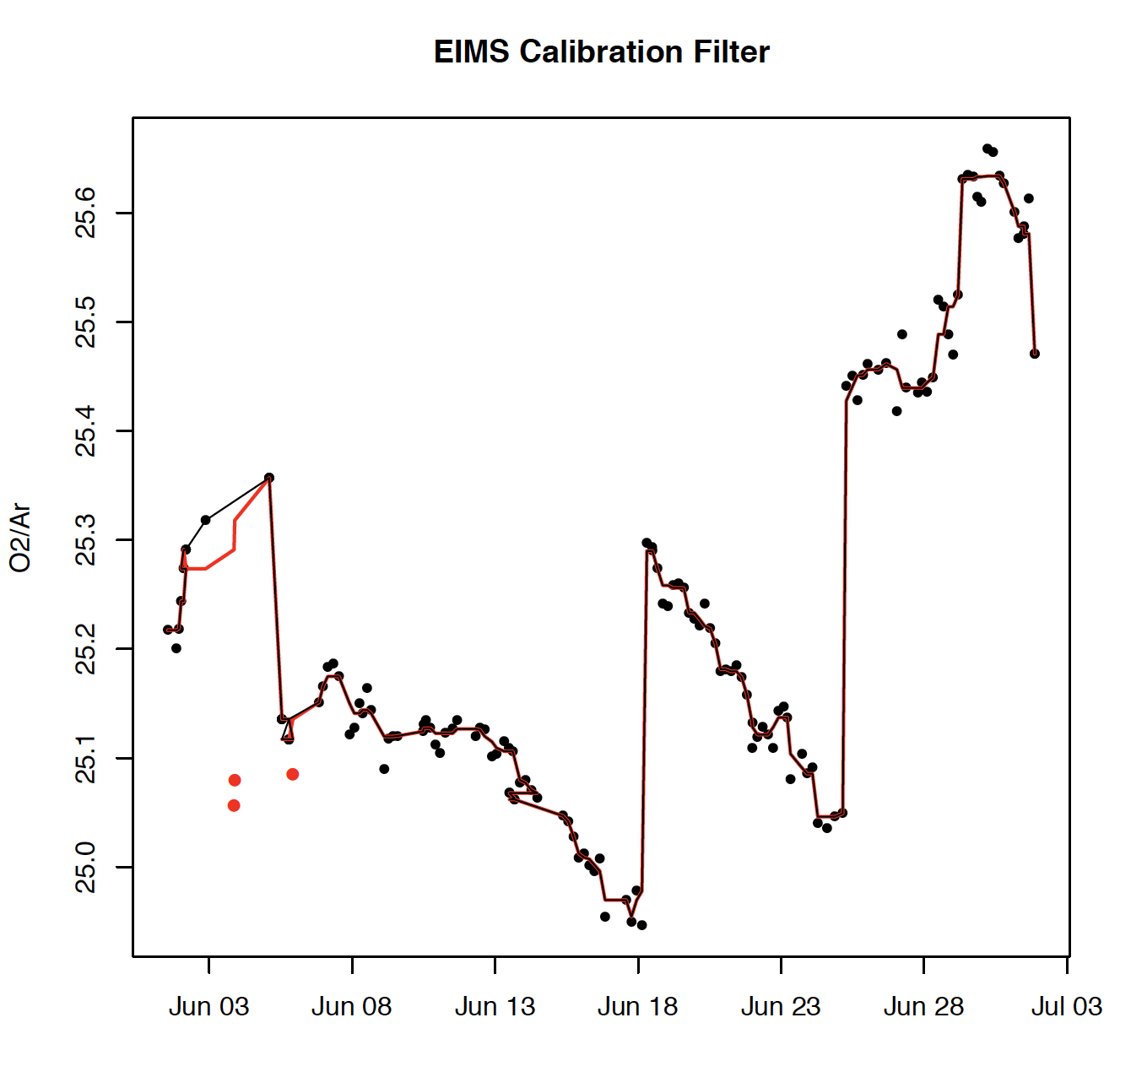
EIMS calibration:
EIMS calibration is very consistent, ranging between 25 to 25.6 .

Slide 8
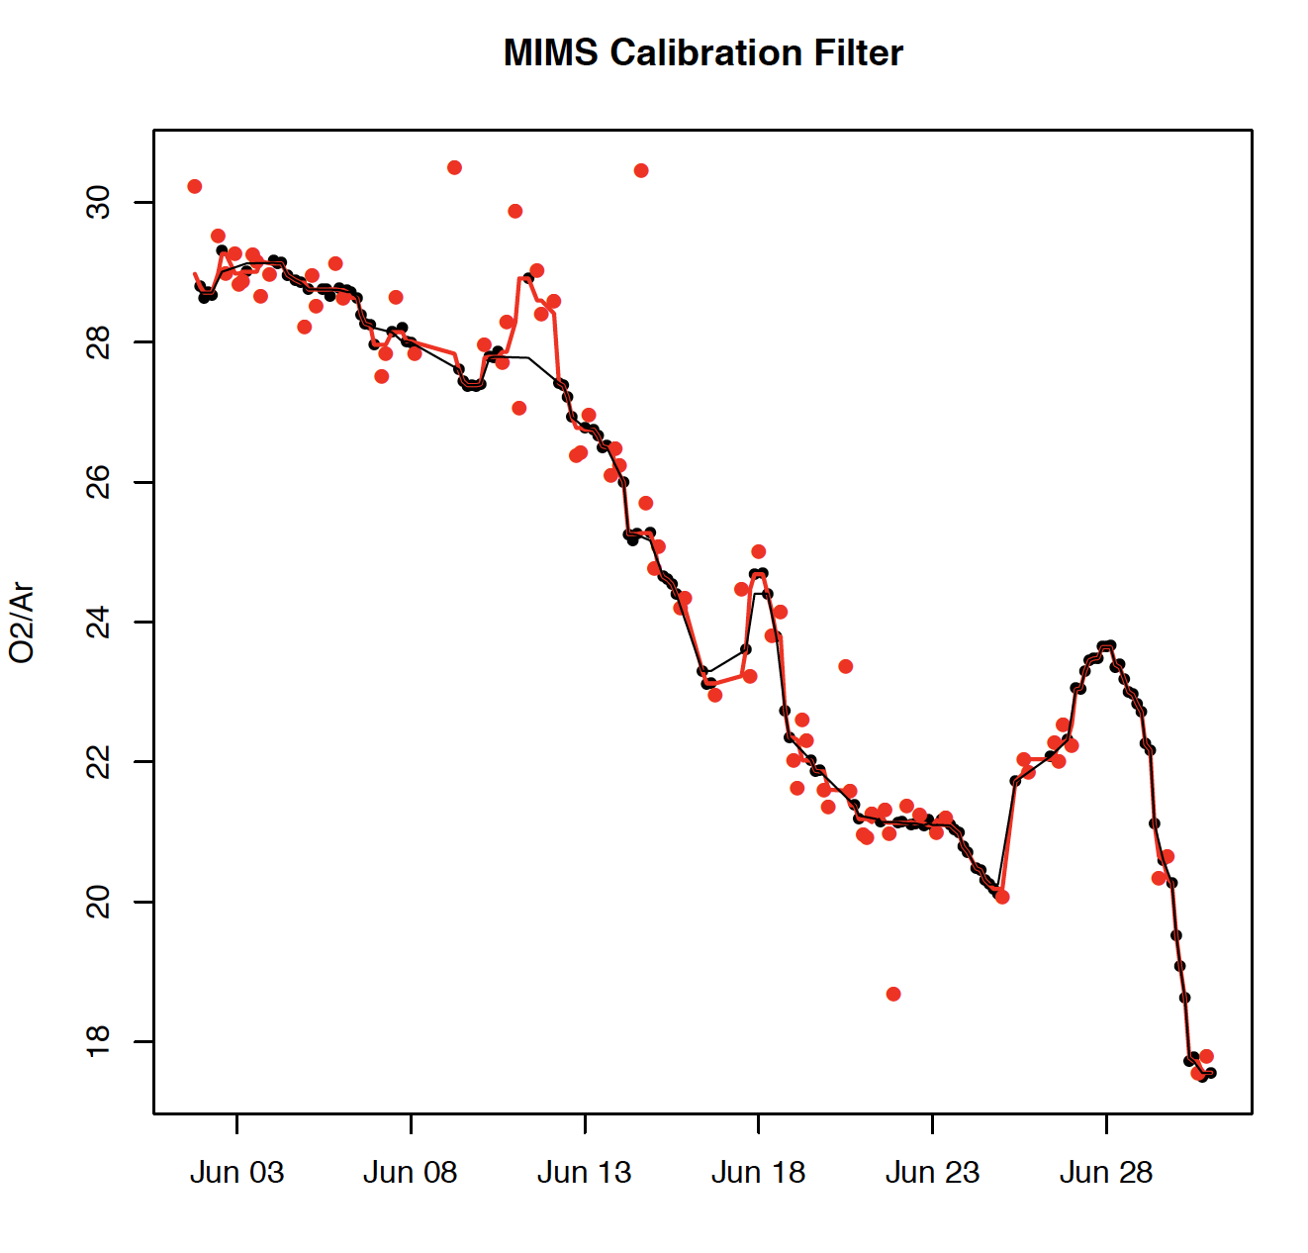
MIMS calibration:
MIMS calibration shows a strong drift!
This is likely due to the change in membrane diffusivity for O2 and Ar and or potentially due to H2O in the system?
Ionization changes?
0.01mm PTFE membrane with 0.5mm PTFE frit.
Changed membrane around June 18. Did not change the frit!
O2 conc. in calibration was relatively constant (+- 2%)
-> TOM – can you plot this?

Slide 9
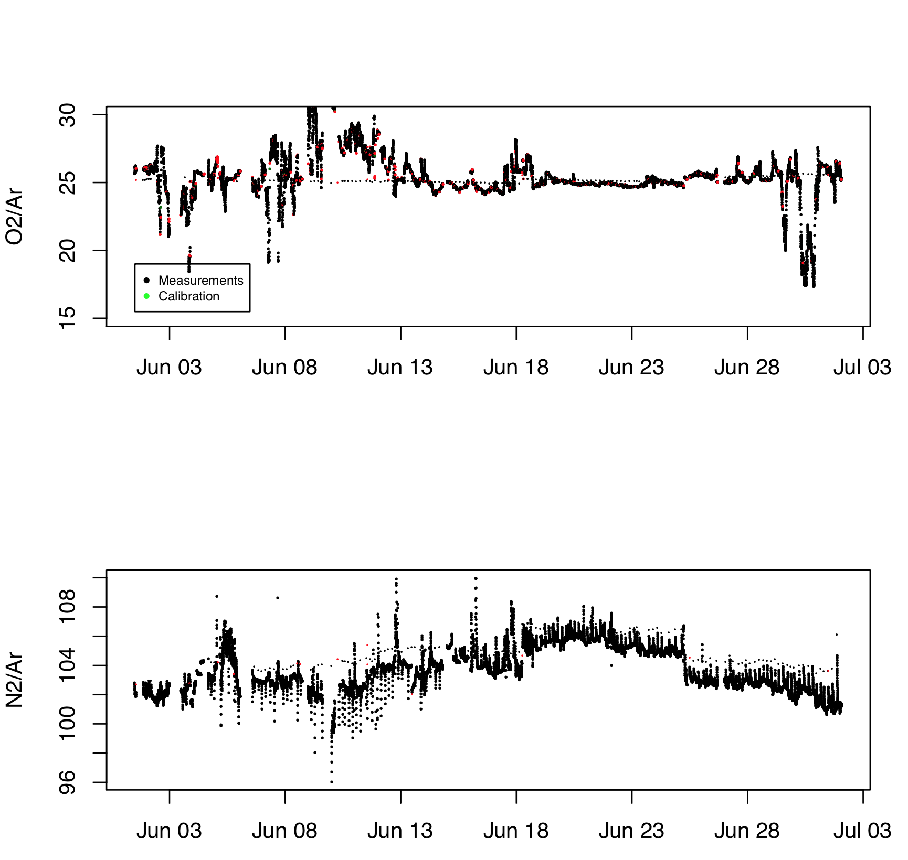
EIMS data
Red dots -outlier

Slide 10
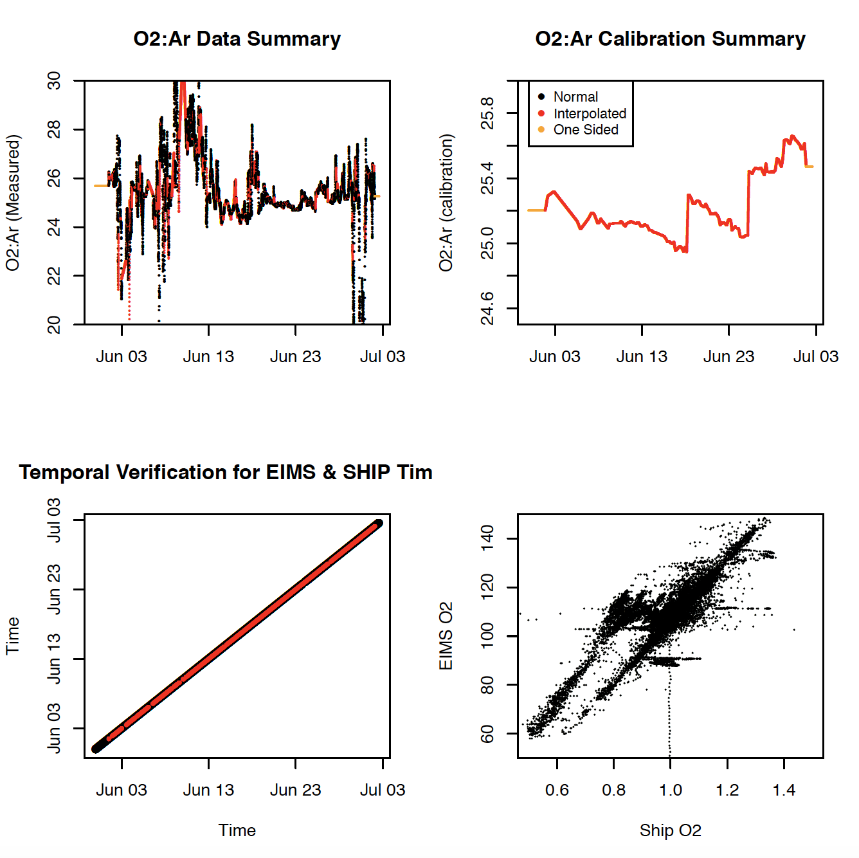
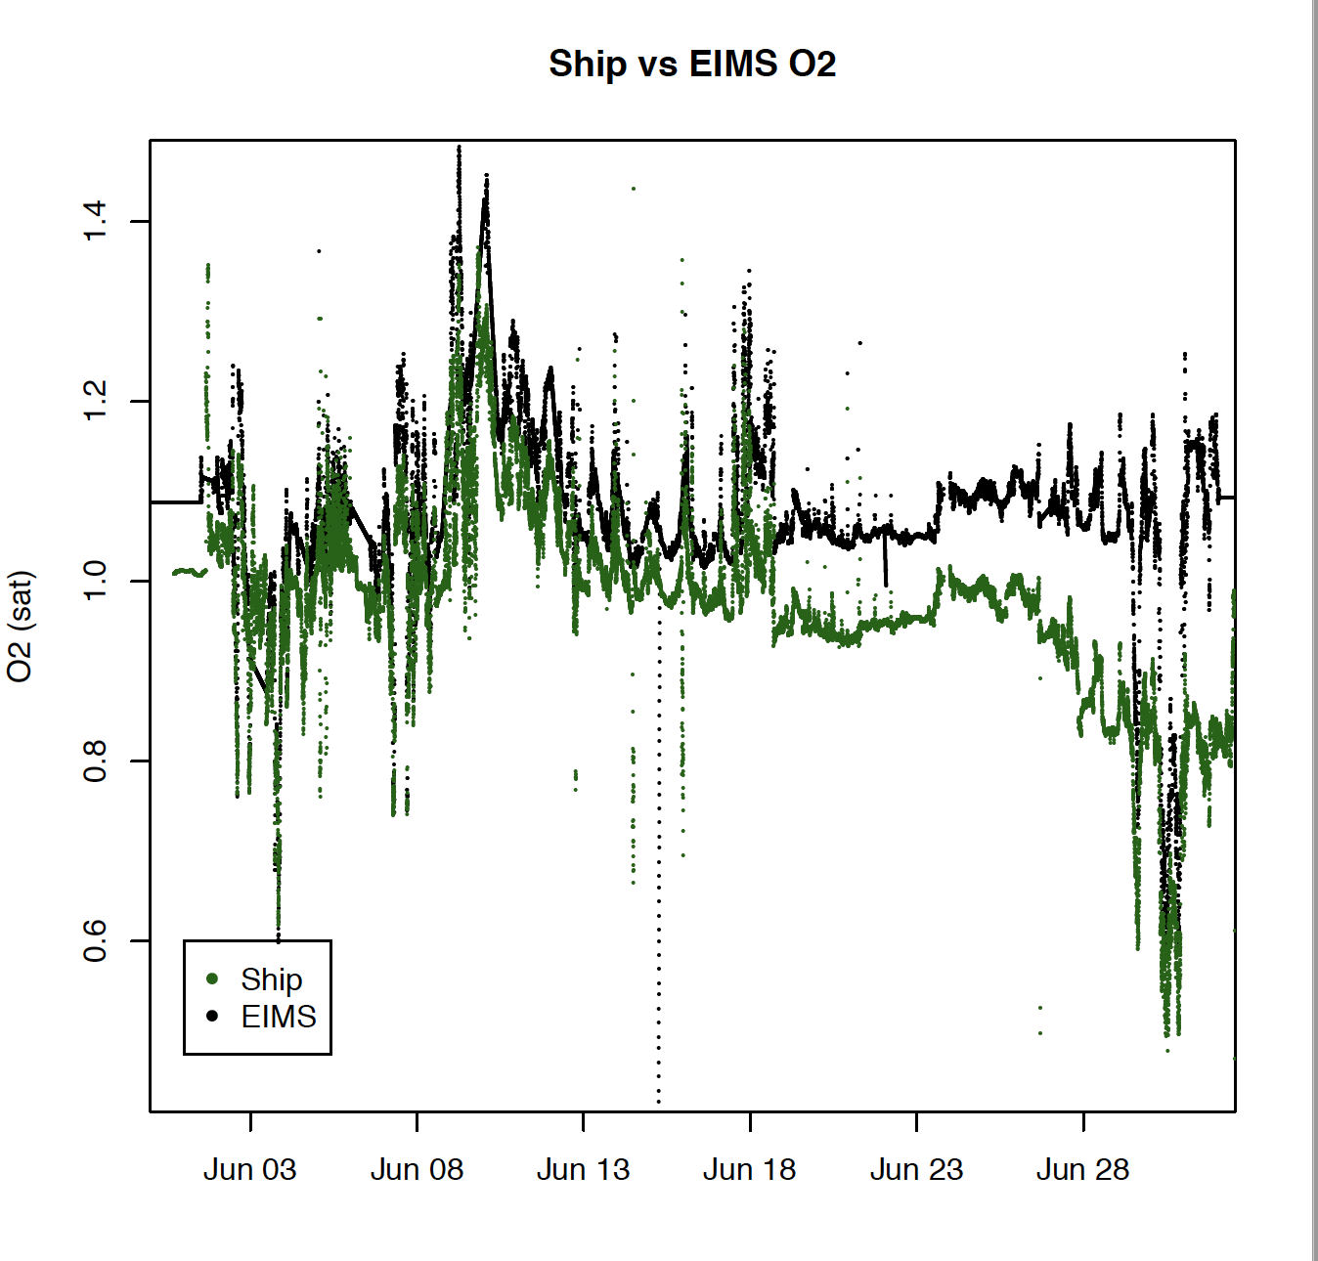
EIMS data
EIMS-O2 data deviate!!!! Why?

Slide 11
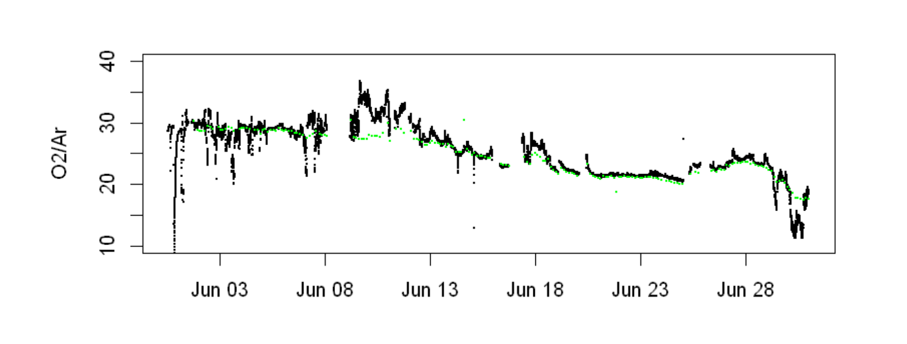
MIMS data

Slide 12
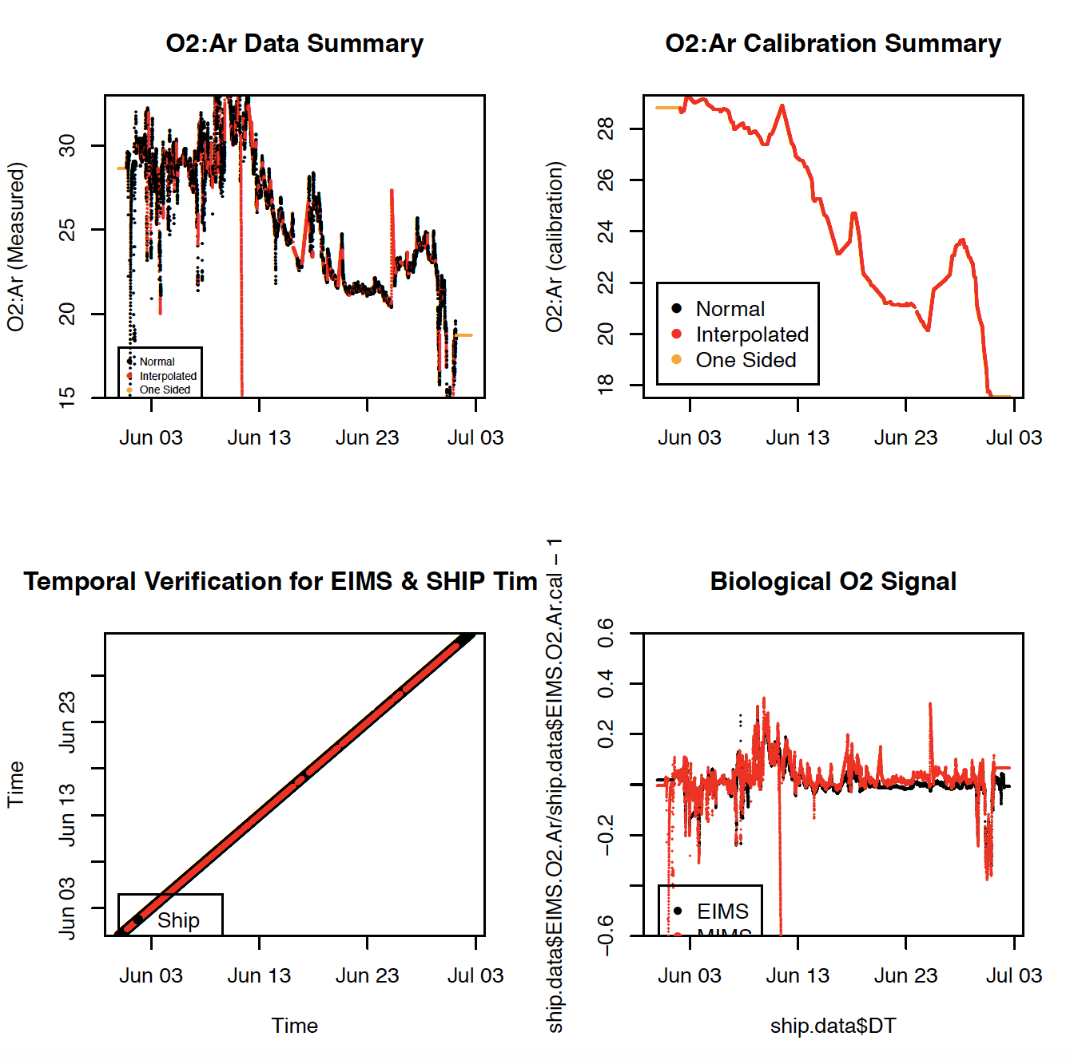
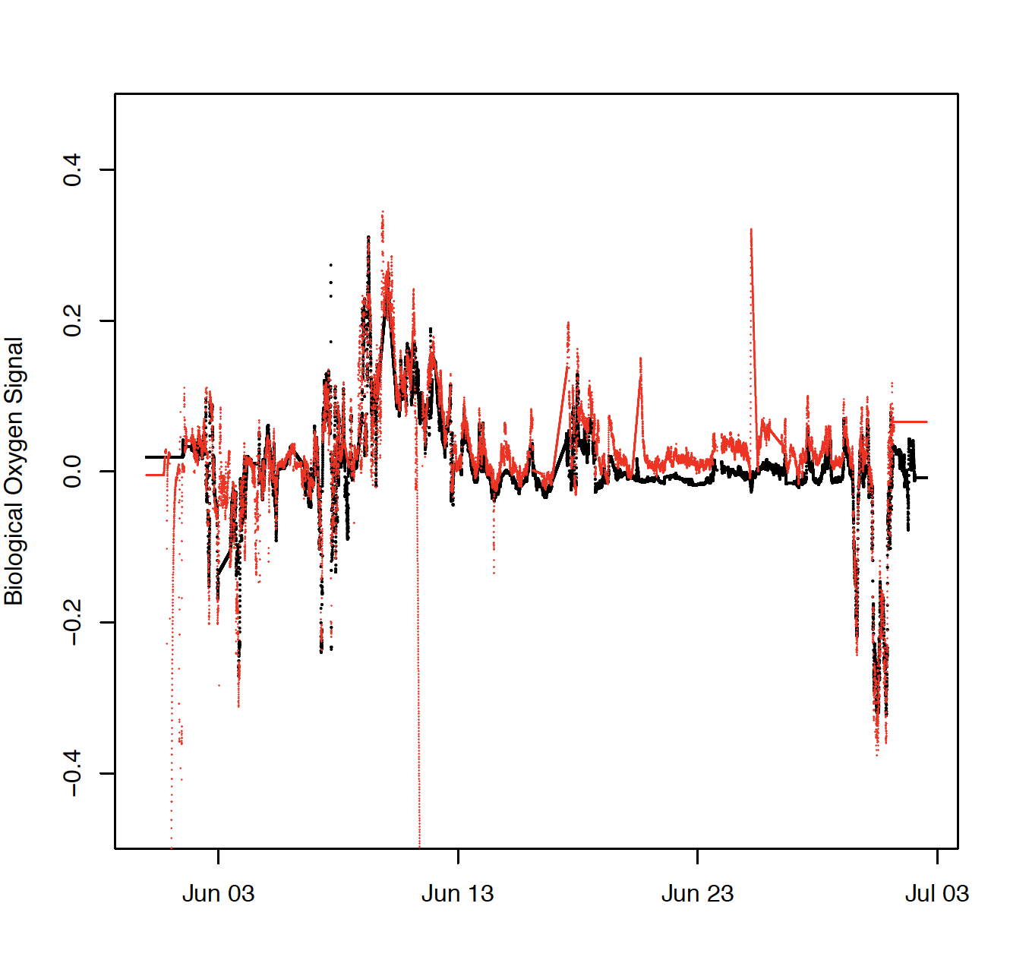
MIMS data

Slide 13
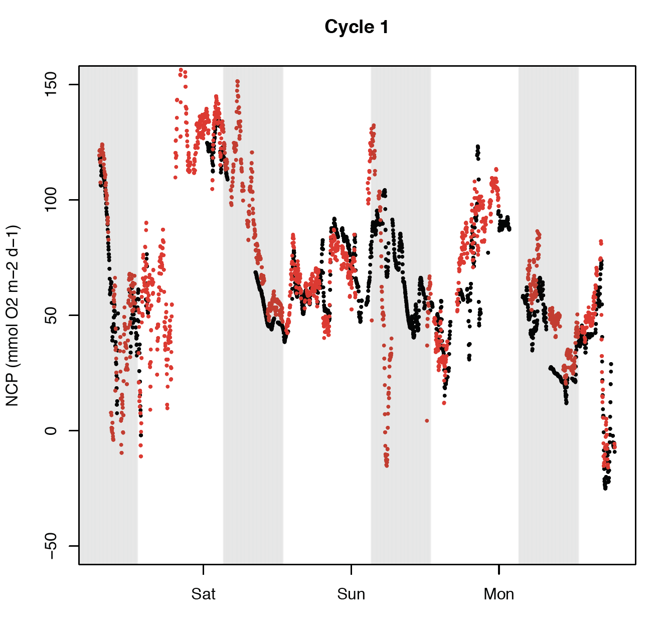
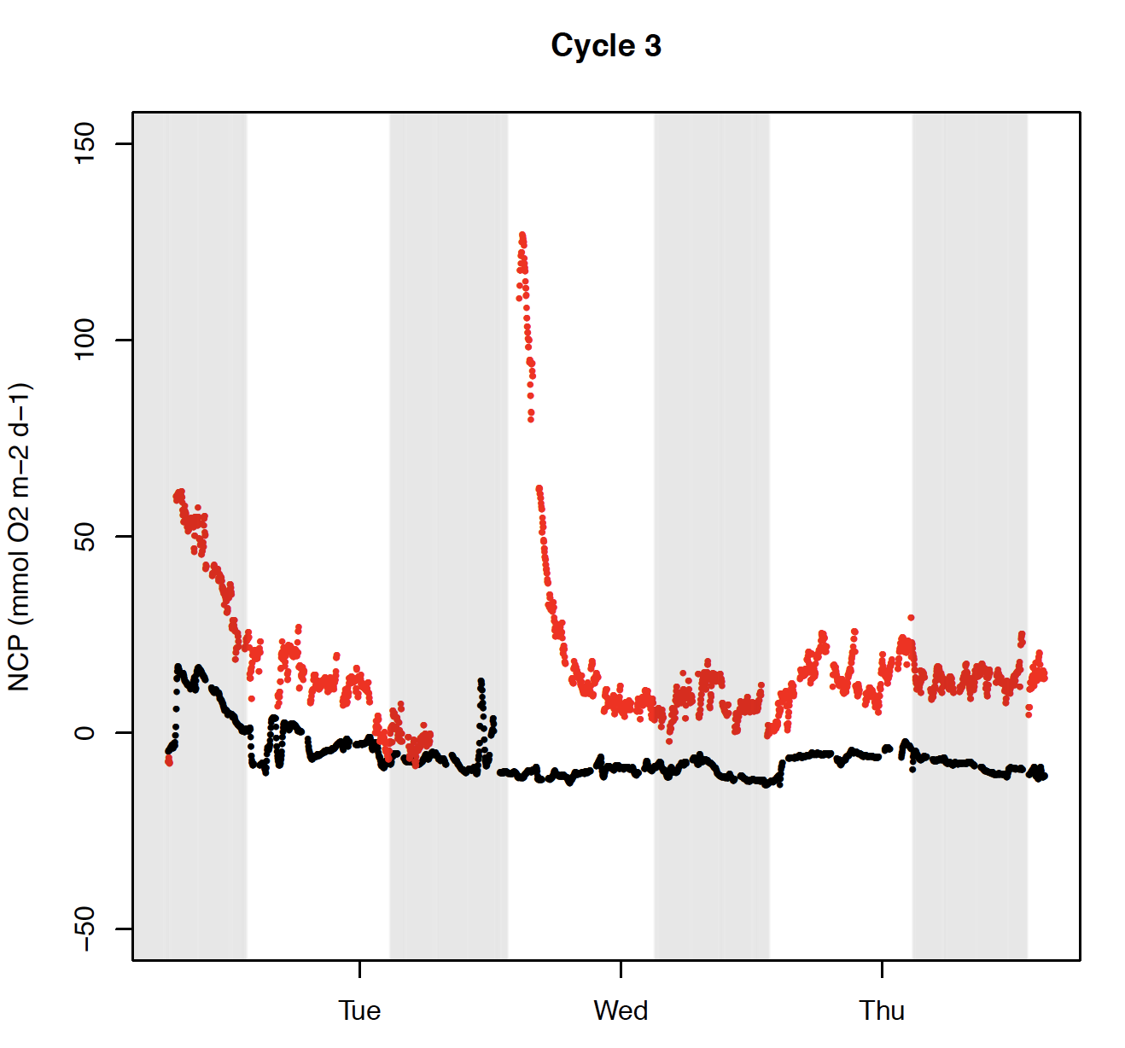
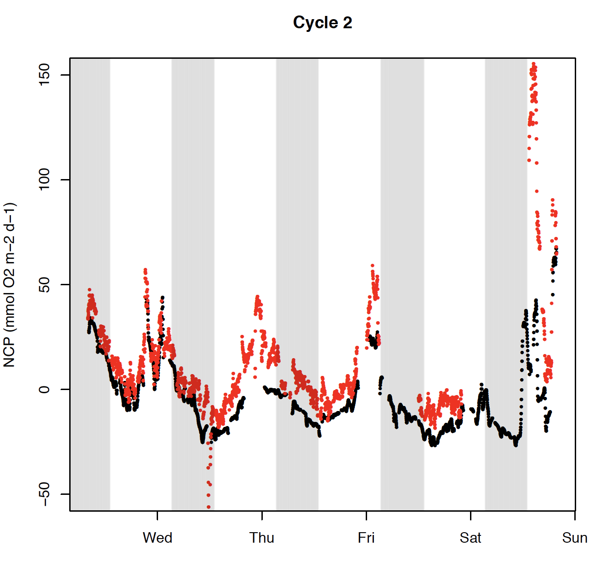
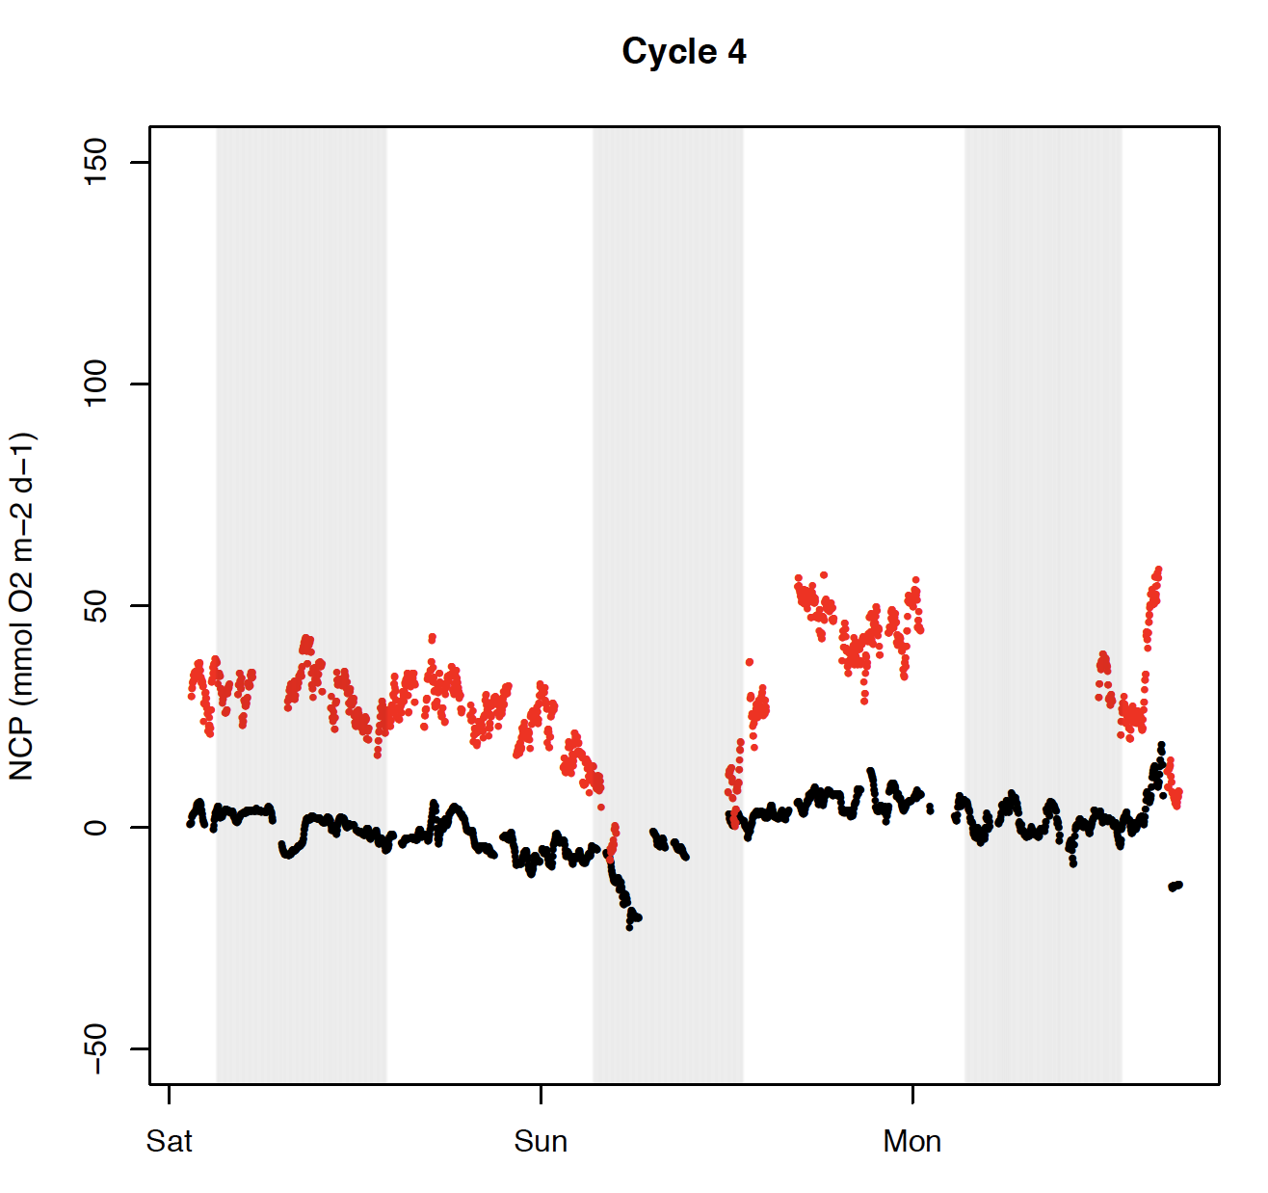
MIMS vs. EIMS NCP stations
Deviation of NCP in cycles 3 and 4!!
Why?
Clear diurnal pattern in cycles 1 and 2
Add light intensity!
Add wind-speed!

Slide 14
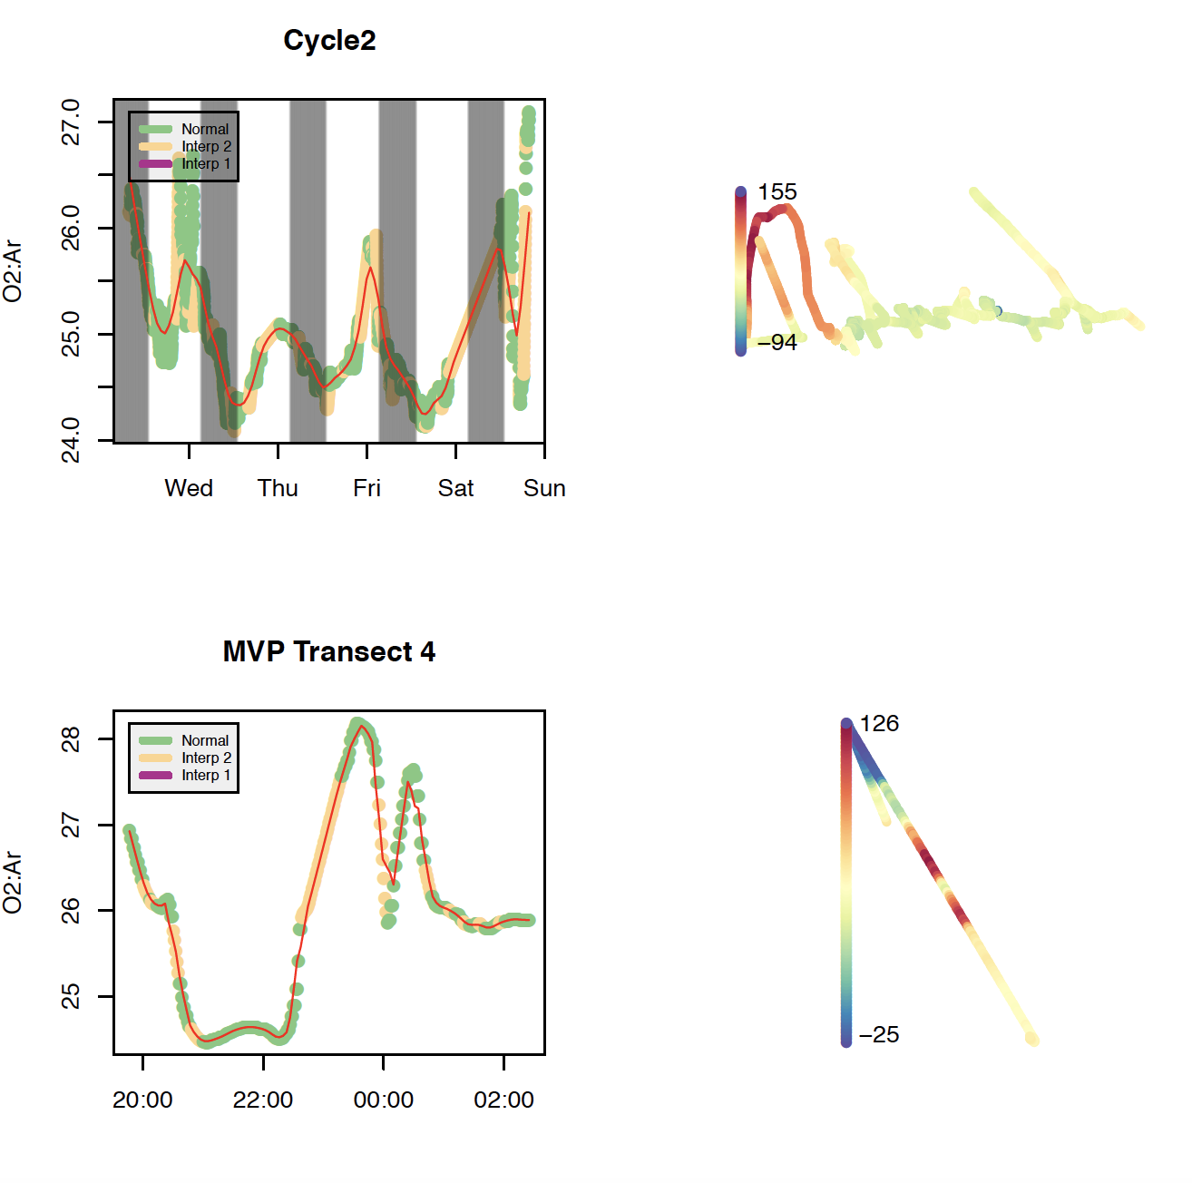
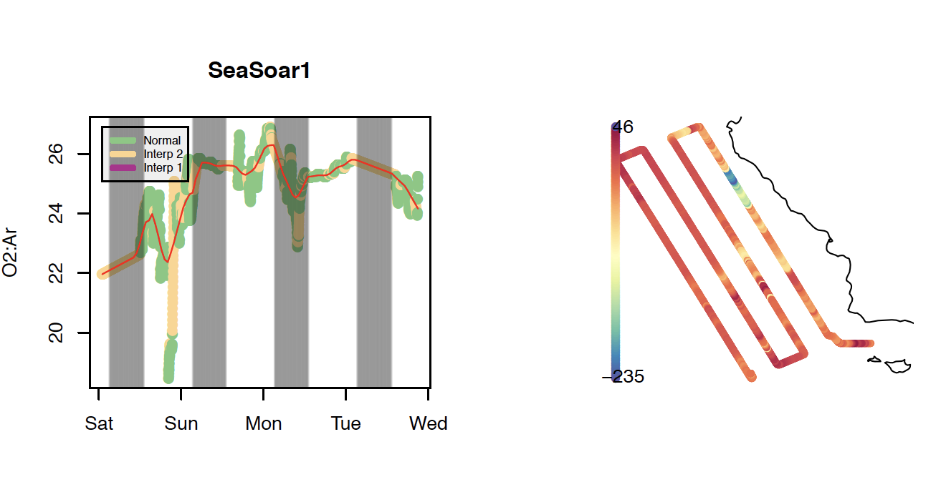
EIMS spatial data
Example EIMS:

Slide 15
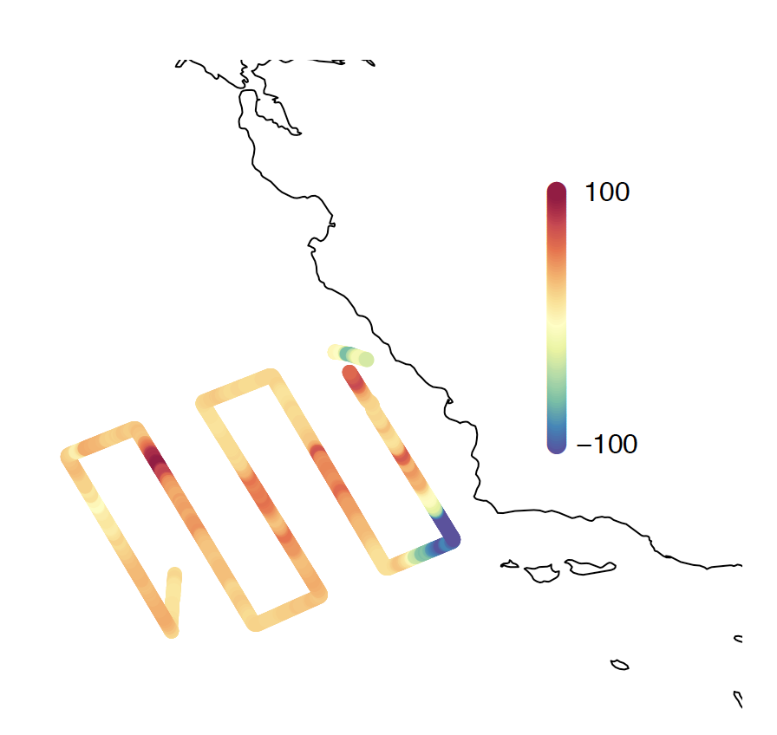
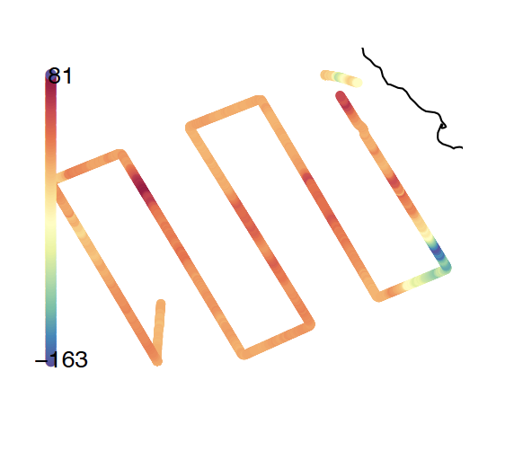
Data – spatial EIMS vs. MIMS
NCP MIMS SEASOAR2
NCP EIMS SEASOAR2

Slide 16
Add MIMS EIMS NCP data over time

Slide 17
Further data analysis / comparison
Use CCE-LTER dataset to verify data!
14C (N)PP (24h) in situ from MLD + below (for model) with constrains
Bacteria productivity (resp1)- in the mixed layer
Grazing rate (resp2) – in the mixed layer
Chl a
Species
Secondary productivity
Biomass?
Export and new production!
Add data from on-deck incubation (CACLOFI) to constrain PP pattern in the CCE region
use O2 profiles…

Slide 18
Diurnal cycles
Use O2 flux – not NCP!
Data from cycles 1-4

Slide 19
Impact of diurnal cycles on NCP analysis:
See Jonsson et al 2013 – work on MLD and wind – use his model framework to analyze diurnal impact!
Diurnal NCP is supposed to include the O2 signal from the past days (*k)- yet diurnal O2 changes dramatically – hence diurnal changes influence O2/Ar analysis!
Use of cycle (1 and 2) data (up to 4 days) -
Build model framework!
Use of high frequency FRRF GP data to potentially correct for the diurnal signal in the SEASOAR data!

Slide 20
Impact of hydro-dynamics on NCP
Use O2 profile data
Use physical model (ROMS model – 40VARS version)
Use O2/Ar profiles

Slide 21
FRRF
Available data:
Ek – light saturation
JVPII (mol electrons PSII-1 m-3 d-1) – to be converted to mol C fix
Calculate/plot electron transport for each of the cycles / cruise segments – using P-E analysis and (incident or average) light intensity throughout the mixed layer.

Slide 23
O2-Ar profiles

Slide 24
Data:
3 profiles to approx. 50m
Using a Well pump and tubing connected to the MIMS/EIMS inlet
Profile @1m/min - upwards
Flow rate: approx 10L/min into the inlet system
Delay: approx 20 sec from intake to MIMS
Duration approx. 1h of measurement

Slide 25
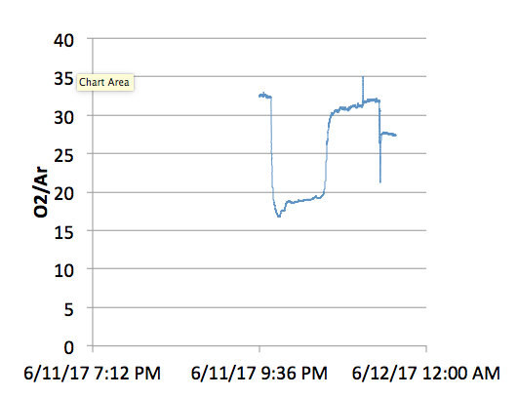
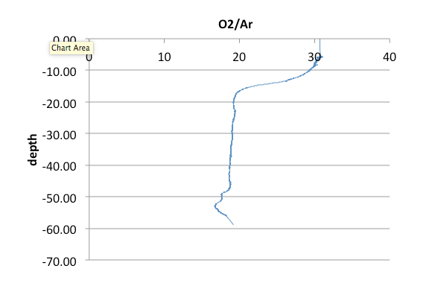
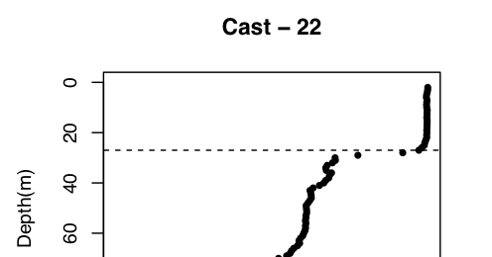
Profiles
surface
52m
Profile chronology
Depth O2/Ar profile uncorrected for pressure and temperature!
– do we have to?
MLD is 25m but O2/Ar MLD around 18m

Slide 26
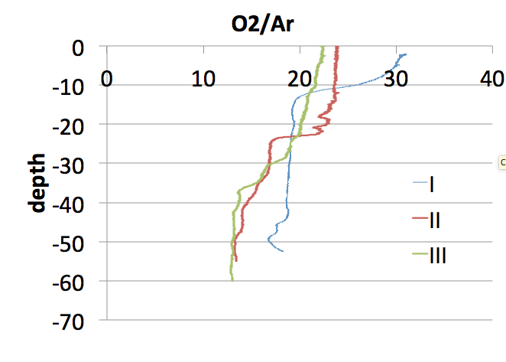

Slide 27
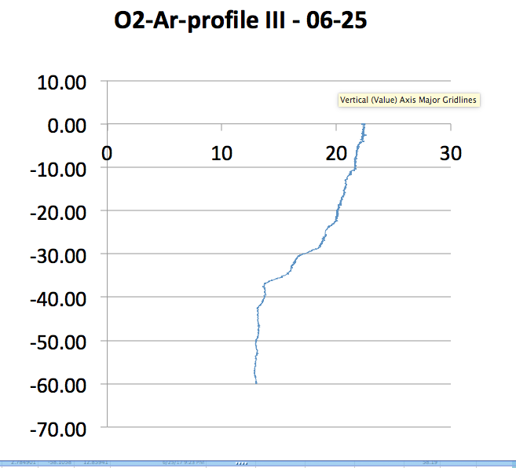
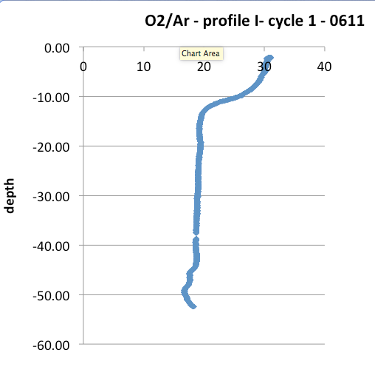
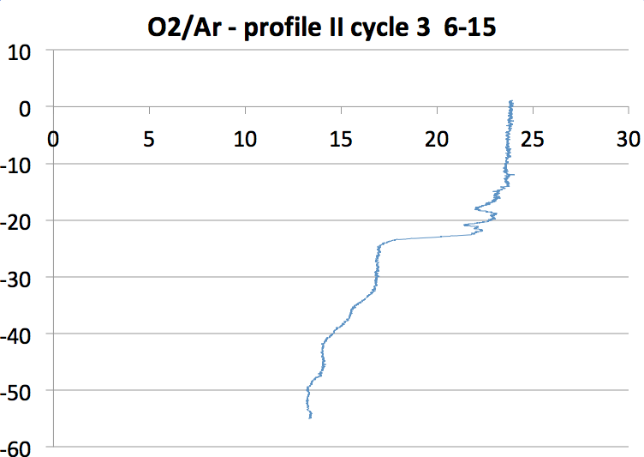
Cast 23 MLD 23m
Cast 32? MLD 22m
Cast 74 – MLD 12

